Slide 1
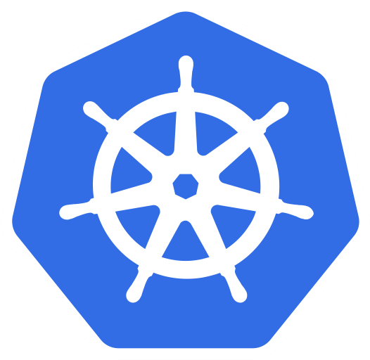



KUBERNETES
( Part 3 )
Prepared by: Aamir Pinger
fb.com/AamirPingerOfficial
linkedin.com/in/AamirPinger
github.com/AamirPinger

Slide 2
SERVICE

Slide 3
Service
When we create pod, our application is not accessible to outer world
We then used kubectl port-forward to forward the pod
Port-forward command solve our problem by making single specified pod to outer world
Think of the situation where you have hundreds of pods and each pod have multiple copies
In the situation like that port-forward is not the best option to use
Instead we create a resource provided by kubernetes called Service

Slide 4
Service
We have learnt that every pod has it own IP address
We have learnt that kubernetes can groups pods providing at a single static IP address
Service resource is the one which is used to create a single, constant point of entry to a group of pods
Each service resource has an IP address and port that never changes while the service resource exists
By using that IP and Port provided by service resource, we can access our application
Even if pod moves around the cluster, service IP don’t change and you get diverted to the new location where the pod is rescheduled

Slide 5
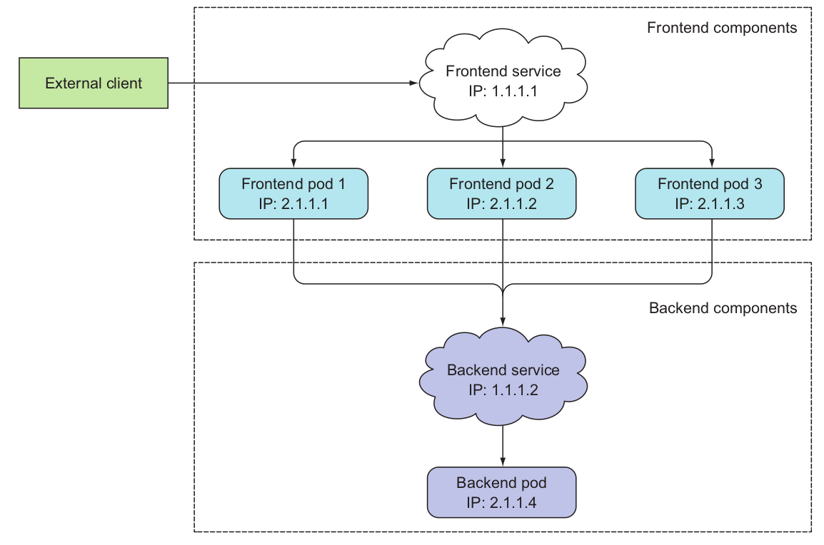
Service
Both Frontend and backend app components are exposed with Kubernetes Service resource
That means, even frontend and backend Pods IP address changes in case of relocation or recreation, user can externally or app can internally communicate with each other without any hazzel

Slide 6
Service
Service resource has many types, few of them are
Cluster IP
Node Port
Load Balancer
External Name

Slide 7
Service
ClusterIP (default)
Exposes the Service on an internal IP in the cluster
This type makes the Service only reachable from within the cluster
We can check it by minikube ssh and than clusterIP:port
NodePort
Exposes the Service on the same port of each selected Node in the cluster
Port range is 30000 to 32767
Makes a Service accessible from outside the cluster using <NodeIP>:<NodePort>

Slide 8
Service
LoadBalancer
Creates an external load balancer for traffic
Assigns a fixed, external IP to the Service
ExternalName
To create a service that serves as an alias for an external service
Let’s say your database is on AWS and it has the following URL test.database.aws.com
By create externalName you can have let’s say my-db diverted to test.database.aws.com

Slide 9
Service
my-svc.yaml
apiVersion: v1
kind: Service
metadata:
name: my-service
spec:
ports:
- port: 8080
targetPort: 80
selector:
app: myapp
type: LoadBalancer
Label: app=myapp
POD-1
Service name:
my-service
Selector: app=myapp
Label: app=myapp
POD-2
Label: app=myapp
POD-3

Slide 10
Service
apiVersion: v1
kind: Service
metadata:
name: my-ext-svc
spec:
type: ExternalName
externalName: ap12.mlab.com
For example you want to make a service of a mongodb database which is hosted at mlab.com
By creating external service you don’t need to use your mlab path to use your database, instead you will use service name
Now we can use following
mongodb://<dbuser>:<dbpassword>@my-ext-svc:<port>/dev
Source: https://cloud.google.com/blog/products/gcp/kubernetes-best-practices-mapping-external-services

Slide 11
Service
Another way to create service
aamir@ap-linux:~$ kubectl expose rs myrs --port=8000 --target-port=80 --type=LoadBalancer --name my-svc-lb --selector=app=rsexample
service/my-svc-lb exposed
aamir@ap-linux:~$ kubectl get svc
NAME TYPE CLUSTER-IP EXTERNAL-IP PORT(S) AGE
my-svc-lb LoadBalancer 10.111.102.249 <pending> 8000:32117/TCP 2m
...

Slide 12
HEALTH CHECK

Slide 13
HEALTH CHECK
One of the main benefits of using Kubernetes it keep our containers running somewhere in the cluster
But what if one of those containers dies? What if all containers of a pod die?
If app container crashes because of bug in your app, Kubernetes will restart your app container automatically
But what about those situations when your app stops responding because it falls into an infinite loop or a deadlock?
Kubernetes provide use way to check health of you application

Slide 14
LIVENESS PROBES

Slide 15
Liveness Probes
Pods can be configured to periodically check an application’s health from the outside and not depend on the app doing it internally
You can specify a liveness probe for each container in the pod’s specification
Kubernetes will periodically execute the probe and restart the container if the probe fails
IMPORTANT POINT: “Container is restarted” means old one is killed and a completely new container is created — it’s not the same container being restarted again

Slide 16
Liveness Probes
There are three types of probes
HTTP GET
This type of probe send request on the container’s IP address, a port and path you specify
Probe is considered a failure and Container will be automatically restarted if
Probe receives error response code
Container app doesn’t respond at all

Slide 17
Liveness Probes
TCP SOCKET
TCP Socket probe tries to open a TCP connection to the specified port of the container
If the connection is established successfully, the probe is successful
Otherwise, the container is restarted.

Slide 18
Liveness Probes
EXEC Probe
An Exec probe executes some commands you provide inside the container and checks the command’s exit status code
If the status code is 0, the probe is successful
All other codes are considered failures

Slide 19
Liveness Probes
my-ln-exec.yaml
kind: Pod
apiVersion: v1
metadata:
name: myapp-ln-exec
spec:
containers:
- name: myapp
image: aamirpinger/hi
ports:
- containerPort: 80
livenessProbe:
exec:
command:
- cat
- /tmp/healthy
my-ln-tcp.yaml
kind: Pod
apiVersion: v1
metadata:
name: myapp-ln-tcp
spec:
containers:
- name: myapp
image: aamirpinger/hi
ports:
- containerPort: 80
livenessProbe:
tcpSocket:
port: 80
my-ln-http.yaml
kind: Pod
apiVersion: v1
metadata:
name: myapp-ln-http
spec:
containers:
- name: myapp
image: aamirpinger/hi
ports:
- containerPort: 80
livenessProbe:
httpGet:
port: 80
path: /

Slide 20
Liveness Probes
There are additional properties which can be defined with any numbers in any of liveness probe. For example:
livenessProbe:
httpGet:
path: /
port: 80
failureThreshold: 3
periodSeconds: 10
successThreshold: 1
timeoutSeconds: 1
initialDelaySeconds: 15
This tells to restart the container in case of 3 consecutive failure

Slide 21
Liveness Probes
There are additional properties which can be defined with any numbers in any of liveness probe. For example:
livenessProbe:
httpGet:
path: /
port: 80
failureThreshold: 3
periodSeconds: 10
successThreshold: 1
timeoutSeconds: 1
initialDelaySeconds: 15
Run this liveness Probe every 10 seconds

Slide 22
Liveness Probes
There are additional properties which can be defined with any numbers in any of liveness probe. For example:
livenessProbe:
httpGet:
path: /
port: 80
failureThreshold: 3
periodSeconds: 10
successThreshold: 1
timeoutSeconds: 1
initialDelaySeconds: 15
Reset the failureThreshold counter on 1 successful response

Slide 23
Liveness Probes
There are additional properties which can be defined with any numbers in any of liveness probe. For example:
livenessProbe:
httpGet:
path: /
port: 80
failureThreshold: 3
periodSeconds: 10
successThreshold: 1
timeoutSeconds: 1
initialDelaySeconds: 15
Response must come within 1 second. Mark failure even successful response comes after specified time in seconds

Slide 24
Liveness Probes
There are additional properties which can be defined with any numbers in any of liveness probe. For example:
livenessProbe:
httpGet:
path: /
port: 80
failureThreshold: 3
periodSeconds: 10
successThreshold: 1
timeoutSeconds: 1
initialDelaySeconds: 15
Kubernetes will wait for 15 seconds to start first liveness probe

Slide 25
READINESS PROBES

Slide 26
Readiness Probes
We have just learned about liveness probes and how they help keep your apps healthy by ensuring unhealthy containers are restarted automatically
Similar to liveness probes, Kubernetes allows you to also define a readiness probe for your pod
The readiness probe is invoked periodically and determines whether the specific pod should receive client requests or not
When a container’s readiness probe returns success, it’s signaling that the container is ready to accept requests

Slide 27
Readiness Probes
This notion of being ready is obviously something that’s specific to each container
Same as liveness probe Kubernetes sends request to container and based on the result either successful or unsuccessful response it decides container is ready to take trafic or still getting ready for that
Unlike liveness probes, if a container fails the readiness check, it won’t be killed or restarted
It is good practice to always add readiness probe even its a simplest app in the container

Slide 28
Readiness Probes
There are three types of probes
HTTP GET
This type of probe send request on the container’s IP address, a port and path you specify
Probe is considered a failure and Container will be treated as not ready and no traffic will get diverted to it

Slide 29
Readiness Probes
TCP SOCKET
TCP Socket probe tries to open a TCP connection to the specified port of the container
If the connection is established successfully, container will marked as ready and it will receive traffic
Otherwise, Kubernetes will wait and rerun the probe to check the status again

Slide 30
Readiness Probes
EXEC Probe
An Exec probe executes some commands you provide inside the container and checks the command’s exit status code
If the status code is 0, the probe is successful
All other codes are considered failures

Slide 31
Readiness Probes
my-rn-exec.yaml
kind: Pod
apiVersion: v1
metadata:
name: myapp-rn-exec
spec:
containers:
- name: myapp
image: aamirpinger/hi
ports:
- containerPort: 80
readinessProbe:
exec:
command:
- ls
- /tmp/ready
my-rn-tcp.yaml
kind: Pod
apiVersion: v1
metadata:
name: myapp-rn-tcp
spec:
containers:
- name: myapp
image: aamirpinger/hi
ports:
- containerPort: 80
readinessProbe:
tcpSocket:
port: 8080
my-rn-http.yaml
kind: Pod
apiVersion: v1
metadata:
name: myapp-rn-http
spec:
containers:
- name: myapp
image: aamirpinger/hi
ports:
- containerPort: 80
readinessProbe:
httpGet:
port: 80
path: /

Slide 32
VOLUMES

Slide 33
Volumes
Container contains its own directories and files
If for any reason kubernetes restarts any container, all files will be lost that we might created at runtime (e.g. log files)
Volumes in kubernetes can be thought of shared directory for the containers in a Pod at a Pod level
Pod level mean the life of that volume is dependent on Pod’s life, If Pod restarts all the files will be lost
Shared directory means all the containers of that pod can share that directory and the files in it

Slide 34
Volumes
Volumes aren’t a standalone Kubernetes object and cannot be created or deleted on their own
Kubernetes volumes are a component of a pod and are thus defined in the pod’s specification—much like containers
A volume is available to all containers in the pod, but it must be mounted in each container that needs to access it
Important Note: Volume name must start and end with alphabets

Slide 35
Volumes
Worker node
Pod 1
Pod 2
Container
1
Container
2
Container 1 : /usr/share/nginx/html
Container 2 : /data
Volume
Container 1 and 2 share volumes with each other
Container 1 and 2 does not any volumes

Slide 36
Volumes
There are many types of volumes
emptyDir
configMap , secret , downwardAPI
persistentVolumeClaim
gitRepo
gcePersistentDisk
awsElasticBlockStore
azureDisk

Slide 37
Volumes
kind: Pod
apiVersion: v1
metadata:
name: my-pod-with-vol
spec:
volumes:
- name: share-dir
emptyDir: {}
containers:
- name: container-one
image: aamirpinger/logfile_nodejs
ports:
- containerPort: 80
volumeMounts:
- name: share-dir
mountPath: /data
- name: container-two
image: aamirpinger/node-js-app
ports:
- containerPort: 8080
volumeMounts:
- name: share-dir
mountPath: /var/c-two

Slide 38
Volumes
To access the container
kubectl exec my-pod-with-vol -it -c container-one -- sh
kubectl exec my-pod-with-vol -it -c container-two -- sh

Slide 39
PERSISTENT VOLUMES

Slide 40
Persistent Volume
Volumes were great as they saves us from data lost incase of container restart
Volumes hold data at a pod level but question may be asked what if for any reason kubernetes terminates the pod e.g. rescheduling the pod
In the case of pod termination data in the volumes will be lost
To solve this issue Kubernetes provides us option of Persistent Volume
Persistent Volume add a volume at a cluster level instead pod level

Slide 41
Persistent Volume
We create a Persistent Volume resource in which we offer cluster level volume that can be used by any pod
Any pod can use that Persistent Volume by using another resource Persistent Volume Claims
Kubernetes Persistent Volumes remains available outside of the pod lifecycle
That means volume will remain even after the pod is deleted
This volume will be available to claim by another pod if required, and the data is retained
POD
PERSISTENT VOLUME CLAIM
PERSISTENT VOLUME

Slide 42
Persistent Volume Claim
It is a kind of formal request from user for claiming a persistent volume
A Persistent Volume Claim describes the amount and characteristics of the storage required by the pod
Based on requirement from user PVC finds any matching persistent volumes and claims it
Depending on the configuration options used for Persistent Volume resource, these PV resource can later be used/claim by other pods

Slide 43
PERSISTENT VOLUMES IN ACTION

Slide 44
Persistent Volume in Action
We will be now creating PV, PVC, and POD
We will be using minikube ssh to check files PV saving on cluster
SSH, or Secure Shell, is a protocol used to securely log onto remote systems
It is the most common way to access remote Linux servers
For any resource yaml file there are 4 part which we write. Kind, apiVersion, metadata, and spec
Spec part of PV carries few special things link accessModes and persistentReclaimPolicy
Let’s discuss these two before we go further writing yaml file for PV and PVC

Slide 45
Persistent Volume Access Modes
Type of accessModes
ReadWriteOnce
Only a single node can mount the volume for reading and writing
ReadOnlyMany
Multiple nodes can mount the volume for reading
ReadWriteMany
Multiple nodes can mount the volume for both reading and writing
RWO , ROX , and RWX pertain to the number of worker nodes that can use the volume at the same time, not to the number of pods!

Slide 46
Persistent Volume Reclaim Policy
We have learned that depending on the configuration options used for Persistent Volume resource, these PV resource can later be used/claim by other pods
The lifetime of a Persistent Volume is determined by its reclaim policy
Reclaim Policy controls the action the cluster will take when a pod releases its ownership of the storage
persistentVolumeReclaimPolicy tag can be used in YAML configuration file at the time of creating PV

Slide 47
Persistent Volume Reclaim Policy
Reclaim Policy can be set to
Delete
Recycle
Retain (Default)
If persistentVolumeReclaimPolicy is Delete
PersistentVolume will be deleted when the PVC is deleted but data will persist
If persistentVolumeReclaimPolicy is Recycle
Volume’s contents will be deleted
Persistent Volume will be available to be claimed again

Slide 48
Persistent Volume Reclaim Policy
If persistentVolumeReclaimPolicy is Retain
If persistentVolumeReclaimPolicy not provided, Retain is default
Kubernetes will retain the volume and its contents after it’s released from its claim
To make PersistentVolume available again for claims can be done by delete and recreate the PersistentVolume resource manually
Underlying storage can either delete or left to be reused by the next pod

Slide 49
Persistent Volume in Action
my-pv.yaml
apiVersion: v1
kind: PersistentVolume
metadata:
name: pv
spec:
accessModes:
- ReadWriteOnce
capacity:
storage: 100M
hostPath:
path: /tmp/pvexmaple
persistentVolumeReclaimPolicy: Delete
my-pvc.yaml
apiVersion: v1
kind: PersistentVolumeClaim
metadata:
name: pvc
spec:
accessModes:
- ReadWriteOnce
resources:
requests:
storage: 100M
storageClassName: “”
my-pv-pod.yaml
apiVersion: v1
kind: Pod
metadata:
name: pv-pod
spec:
volumes:
- name: pvol
persistentVolumeClaim:
claimName: pvc
containers:
- image: aamirpinger/logfile_nodejs
name: container1
volumeMounts:
- name: pvol
mountPath: /data

Slide 50
ConfigMap

Slide 51
ConfigMap
ConfigMaps allow you to separate your application configurations from your application code, which helps keep your containerized applications portable
ConfigMaps are useful for storing and sharing non-sensitive, unencrypted configuration information which you can change at runtime
It help makes their configurations easier to change and manage, and prevents hardcoding configuration data to Pod specifications

Slide 52
ConfigMap
Creating ConfigMaps from literal values on the command line
aamir@ap-linux:~$ kubectl create configmap cm-lit --from-literal=fname=aamir --from-literal=lname=pinger
configmap/cm-lit created
aamir@ap-linux:~$ kubectl get configmap
NAME DATA AGE
cm-lit 2 59s
You also can use kubectl get cm

Slide 53
ConfigMap
To get configMap output in YAML file
aamir@ap-linux:~$ kubectl get configmap cm-lit -o yaml
apiVersion: v1
data:
fname: aamir
lname: pinger
kind: ConfigMap
metadata:
creationTimestamp: "2019-07-19T08:14:20Z"
name: cm-lit
namespace: default
resourceVersion: "399691"
selfLink: /api/v1/namespaces/default/configmaps/cm-lit
uid: a1c98d84-be6f-4a85-9868-d774d760103d

Slide 54
ConfigMap
To get insight of configMap
aamir@ap-linux:~$ kubectl describe configmap cm-lit
Name: cm-lit
Namespace: default
Labels: <none>
Annotations: <none>
Data
====
lname:
----
pinger
fname:
----
aamir
Events: <none>

Slide 55
ConfigMap
To create a configMap and populate key/value data from text file
aamir@ap-linux:~$ kubectl create cm cm-from-file --from-file=user.txt
configmap/cm-from-file created
aamir@ap-linux:~$ kubectl get cm cm-from-file -o yaml
apiVersion: v1
data:
user.txt: |
name=aamir
surname=pinger
kind: ConfigMap
metadata:
name: cm-from-file
...
user.txt
name=aamir
surname=pinger

Slide 56
ConfigMap
You can add custom key instead of file name as a key
aamir@ap-linux:~$ kubectl create cm cm-from-file --from-file=myuserkey=user.txt
configmap/cm-from-file created
aamir@ap-linux:~$ kubectl get cm cm-from-file -o yaml
apiVersion: v1
data:
myuserkey: |
name=aamir
surname=pinger
kind: ConfigMap
metadata:
name: cm-from-file
...
user.txt
name=aamir
surname=pinger

Slide 57
ConfigMap
If you want to get both key/value from file
aamir@ap-linux:~$ kubectl create cm cm-from-env-file --from-env-file=cm.env
configmap/cm-from-env-file created
aamir@ap-linux:~$ kubectl get cm cm-from-env-file -o yaml
apiVersion: v1
data:
CREATEDBY: Aamir Pinger!!!
kind: ConfigMap
metadata:
creationTimestamp: "2019-07-19T10:00:07Z"
name: cm-from-env-file
...
cm.env
CREATEDBY=Aamir PINGER!!!

Slide 58
ConfigMap
ConfigMaps can also be created from a directory of files on the command line
kubectl create configmap cm-lit --from-file=/path/directory_name
Each file name will be key and text inside that file will be value

Slide 59
ConfigMap’s DATA AS VOLUMES

Slide 60
ConfigMap Data as Volumes
kind: Pod
apiVersion: v1
metadata:
name: pod-cm
spec:
volumes:
- name: cm-vol
configMap:
name: cm-from-env-file
cm-pod.yaml
containers:
- name: configmap-container
image: nginx
volumeMounts:
- name: cm-vol
mountPath: /etc/config
aamir@ap-linux:~$ kubectl create -f cm-pod.yaml
pod/pod-cm created
aamir@ap-linux:~$ kubectl exec pod-cm -it -- sh
# cd /etc/config
# ls
CREATEDBY
# cat name
Aamir Pinger!!!#

Slide 61
ConfigMap’s DATA AS ENVIRONMENTAL VARIABLE

Slide 62
ConfigMap Data as Environmental Variable
kind: Pod
apiVersion: v1
metadata:
name: pod-cm-env
labels:
app: cmexample
spec:
containers:
- name: configmap-container
image: aamirpinger/node-app-image
envFrom:
- configMapRef:
name: cm-from-env-file
cm-epod.yaml
aamir@ap-linux:~$ kubectl create -f cm-epod.yaml
pod/pod-cm-env created
aamir@ap-linux:~$ kubectl expose pod pod-cm-env --target-port 8080 --type=LoadBalancer
service/pod-cm-env exposed
aamir@ap-linux:~$ kubectl get svc
http://192.168.99.100:<svc_port_no>

Slide 63
SECRET

Slide 64
Secret
Secrets are also used to pass key/value data to application dynamically like configMaps
Secrets are secure objects which stores sensitive data, such as passwords, OAuth tokens, and SSH keys, in your clusters
Storing sensitive data in Secrets is more secure than plain text ConfigMaps or in Pod specifications
Using Secrets gives you control over how sensitive data is used, and reduces the risk of exposing the data to unauthorized users
The Secret values are Base64 encoded in Kubernetes

Slide 65
Secrets
Secrets can be create from literal values on the command line
kubectl create secret generic secret-lit --from-literal=name=aamir --from-literal=surname=pinger
To get list of Secret
kubectl get secret
To describe Secret
kubectl describe secret <Secret name>

Slide 66
Secrets
To get yaml of any Secret
kubectl get secret <Secret name> -o yaml
To decode secret base64 value
echo YWFtaXI= | base64 -d
Secret creation from single file on the command line
kubectl create secret generic sec-from-file --from-file=data.txt
kubectl create secret generic sec-key-from-file --from-file=<customkey>=data.txt
kubectl create secret generic sec-from-env-file --from-env-file=data.txt

Slide 67
Secret Data as Environmental Variable
sec-epod.yaml
kind: Pod
apiVersion: v1
metadata:
name: pod-scr-env
spec:
containers:
- name: secret-container-env
image: nginx
envFrom:
- secretRef:
name: secret-lit
aamir@ap-linux:~$ kubectl create -f sec-pod.yaml
pod/pod-scr-env created
aamir@ap-linux:~$ kubectl exec pod-scr-env -it -- sh
# env
# echo $name

Slide 68
Secret Data as Volumes
kind: Pod
apiVersion: v1
metadata:
name: pod-scr
spec:
volumes:
- name: scr-vol
secret:
secretName: secret-lit
scr-pod.yaml
containers:
- name: secret-container
image: nginx
volumeMounts:
- name: scr-vol
mountPath: /etc/secret
aamir@ap-linux:~$ kubectl create -f scr-pod.yaml
pod/pod-scr created
aamir@ap-linux:~$ kubectl exec pod-scr -it -- sh
# cd /etc/secret
# ls
name surname
# cat name
aamir#

Slide 69
ENVIRONMENTAL VARIABLE

Slide 70
Environmental Variable
Uptil now we have seen how we can pass environmental variables to containers using envFrom Tag using configMap and Secrets
We also can pass environmental variables hardcoded in pod specification
kind: Pod
apiVersion: v1
metadata:
name: myapp-env
spec:
containers:
- name: myapp
image: nginx
ports:
- containerPort: 80
env:
- name: AUTHOR_FIRST_NAME
value: "Aamir"
- name: FULL_NAME
value: "$(AUTHOR_FIRST_NAME) Pinger"
aamir@ap-linux:~$ kubectl create -f scr-pod.yaml
pod/pod-scr created
aamir@ap-linux:~$ kubectl exec pod-scr -it -- sh
# cd /etc/secret

Slide 71
Environmental Variable
env-pod.yaml
kind: Pod
apiVersion: v1
metadata:
name: pod-env
spec:
containers:
- name: myapp
image: nginx
ports:
- containerPort: 80
env:
- name: AUTHOR_FIRST_NAME
value: "Aamir"
- name: FULL_NAME
value: "$(AUTHOR_FIRST_NAME) Pinger"
aamir@ap-linux:~$ kubectl create -f env-pod.yaml
pod/pod-env created
aamir@ap-linux:~$ kubectl exec pod-env -it -- sh
# echo $FULL_NAME
Aamir Pinger
# env
...

Slide 72
DEPLOYMENT

Slide 73
Deployment
TIll the moment we have learned
How to group our containerized app into pods
Ways to provide them with temporary or permanent storage
How to pass both secret and non-secret config data to them
Allowed pods to find and talk to each other
How to run a full-fledged system composed of independently running smaller components (microservices)

Slide 74
Is there anything else?
?
Eventually, you’re going to want to update your app

Slide 75
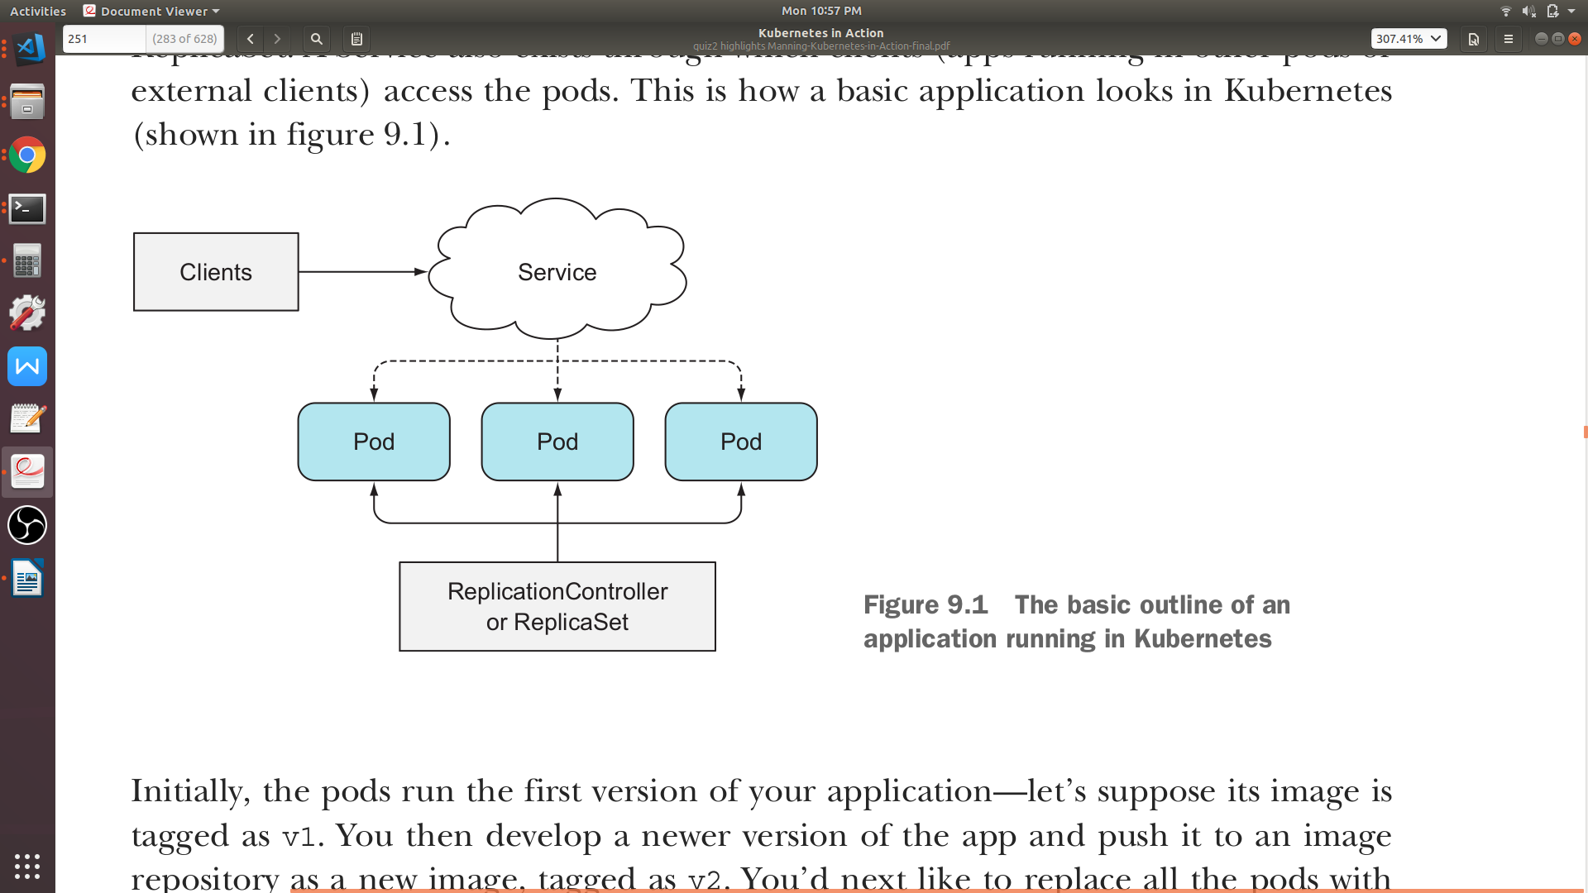
Deployment
Let’s say you created your pod with a container having any image e.g. aamirpinger/helloworld:v1
After sometime you want you running pods to update the image with aamirpinger/helloworld:v2
Because you can’t change an existing pod’s image after the pod is created, you need to remove the old pods and replace them with new ones running the new image
ReplicaSet

Slide 76
Deployment
We have two ways of updating all those pods
Delete all existing pods first and then start the new ones
Start new ones and, once they’re up, delete the old ones
This could be done either by adding all the new pods and then deleting all the old pods at once
Sequentially, by adding new pods and removing old ones gradually

Slide 77
Deployment
Both these strategies have their benefits and drawbacks
The first option would lead to a short period of time when your application is unavailable
The second option requires your app to handle running two versions of the app at the same time but sometimes it’s not possible
What if you added a mandatory field in database and updates your image with new API and API in currently running pods having older version of image does not sends data for that mandatory field

Slide 78
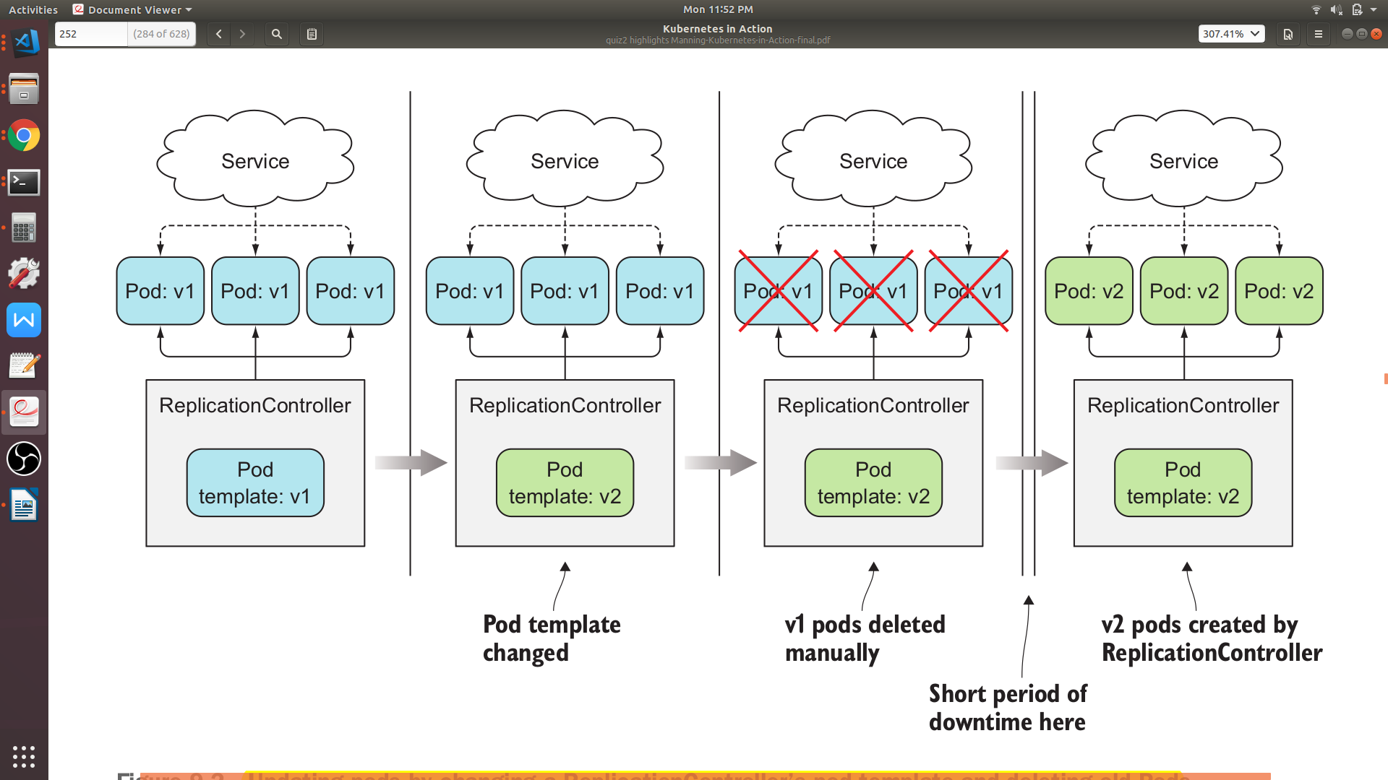
Deployment
ReplicaSet
ReplicaSet
ReplicaSet
ReplicaSet

Slide 79
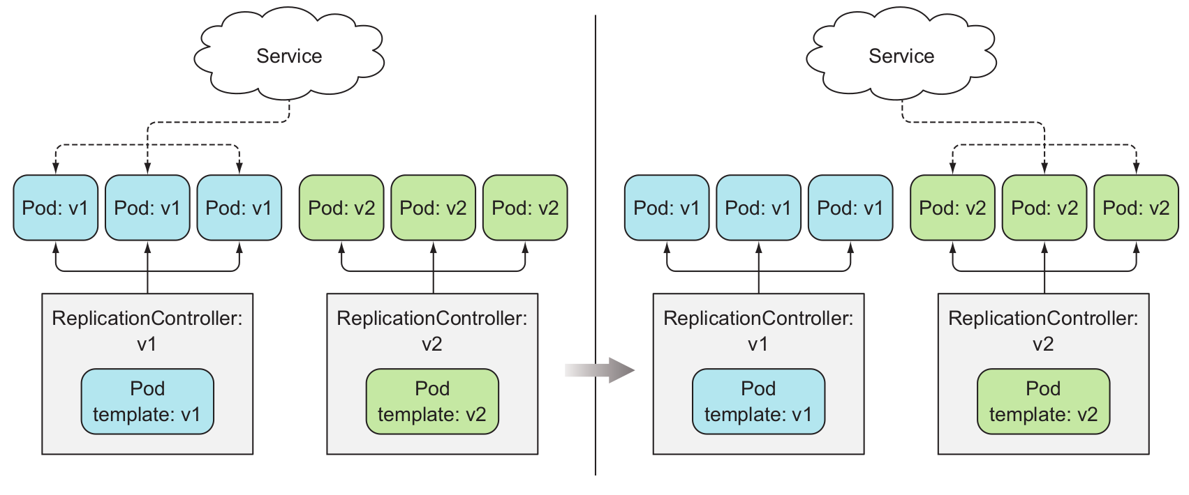
Deployment
ReplicaSet
ReplicaSet
ReplicaSet
ReplicaSet
SWITCHING A SERVICE FROM THE OLD PODS TO THE NEW ONES

Slide 80
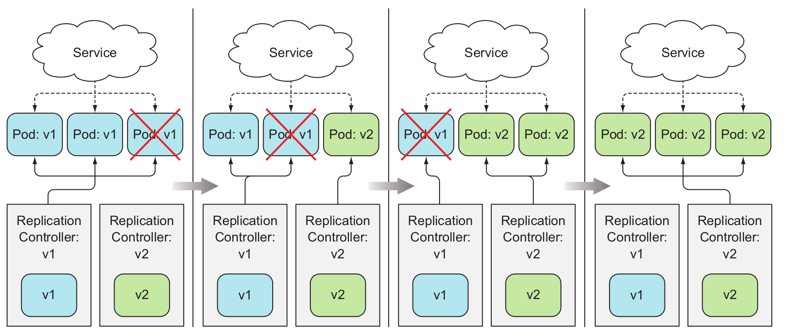
Deployment
ReplicaSet
ReplicaSet
ReplicaSet
ReplicaSet
ReplicaSet
ReplicaSet
ReplicaSet
ReplicaSet

Slide 81
Deployment
Last way of updating your pods app can be done by slowly scaling down the previous RS and scaling up the new one, this is called rolling-update
Service’s pod selector to include both the old and the new pods, so it directs requests toward both sets of pods (Problem: database example we just discussed)
Doing a rolling update manually is laborious and error-prone
Depending on the number of replicas, you’d need to run a dozen or more commands in the proper order to perform the update process

Slide 82
Deployment
Luckily kubernetes provide us a resource which do all the update on behalf of us automatically
A Deployment is a resource meant for deploying applications and updating them declaratively
When you create a Deployment, a ReplicaSet resource is created underneath
When using a Deployment, the actual pods are created and managed by the Deployment’s ReplicaSets, not by the Deployment directly
DEPLOYMENT
ReplicaSet
PODS
0

Slide 83
Deployment
apiVersion: apps/v1
kind: Deployment
metadata:
name: my-deploy
spec:
replicas: 4
selector:
matchLabels:
app: deploy-app
template:
metadata:
name: deploy-pod
labels:
app: deploy-app
spec:
containers:
my-deploy.yaml
- image: aamirpinger/helloworld
name: container1
imagePullPolicy: IfNotPresent

Slide 84
Deployment
aamir@ap-linux:~$ kubectl create -f my-deploy.yaml --record
deployment.apps/my-deploy created
aamir@ap-linux:~$ kubectl expose deploy my-deploy --type=LoadBalancer --port=80
service/my-deploy exposed
aamir@ap-linux:~$ kubectl get deploy,rs,pod,svc
...
aamir@ap-linux:~$ minikube ip
192.168.99.100
aamir@ap-linux:~$ curl 192.168.99.100:<port>
...
aamir@ap-linux:~$ kubectl set image deploy my-deploy container1=aamirpinger/hi
deployment.extensions/my-deploy image updated
aamir@ap-linux:~$ while true; do curl 192.168.99.100:port ; done
...

Slide 85
Deployment
Deployment can be set with two rolling update strategies
Recreate
In this strategy, all the old pods get deleted at once and then new pods get created
Problem: Downtime
RollingUpdate (Default)
Removes old pods one by one, while adding new ones at the same time, keeping the application available throughout the whole process
maxSurge and maxUnavailable, these two properties affect how many pods are replaced at once during a Deployment rolling update

Slide 86
Deployment
apiVersion: apps/v1
kind: Deployment
metadata:
name: my-deploy-ru
spec:
replicas: 4
selector:
matchLabels:
app: deploy-app
template:
metadata:
name: deploy-pod-ru
labels:
app: deploy-app-ru
spec:
containers:
- image: aamirpinger/helloworld
name: container
strategy:
rollingUpdate:
maxSurge: 1
maxUnavailable: 0
type: RollingUpdate
maxUnavailable: 0 will make sure pods unavailability cannot be less than desired replica count. In our case desired replica count is 4

Slide 87
Deployment
apiVersion: apps/v1
kind: Deployment
metadata:
name: my-deploy-ru
spec:
replicas: 4
selector:
matchLabels:
app: deploy-app
template:
metadata:
name: deploy-pod-ru
labels:
app: deploy-app-ru
spec:
containers:
- image: aamirpinger/helloworld
name: container
strategy:
rollingUpdate:
maxSurge: 1
maxUnavailable: 0
type: RollingUpdate
maxUnavailable determines how many pod can be unavailable during the update process. Default is number nearest round off to 25% of replica count. I.e. availability of Pod will be minimum 75% of desired replica count

Slide 88
Deployment
apiVersion: apps/v1
kind: Deployment
metadata:
name: my-deploy-ru
spec:
replicas: 4
selector:
matchLabels:
app: deploy-app
template:
metadata:
name: deploy-pod-ru
labels:
app: deploy-app-ru
spec:
containers:
- image: aamirpinger/helloworld
name: container
strategy:
rollingUpdate:
maxSurge: 1
maxUnavailable: 0
type: RollingUpdate
maxSurge determines how many pod can be created with a updated image before deleting the old pod. Default is number nearest round off to 25% of replica count. In our case total new/old all together 5 pods can be up at any particular time

Slide 89
Deployment
kubectl set image deploy my-deploy container1=aamirpinger/flag
kubectl rollout pause deployment my-deploy-ru
kubectl rollout resume deployment my-deploy-ru
kubectl rollout status deployment my-deploy-ru
kubectl rollout history deployment my-deploy-ru
kubectl rollout undo deployment my-deploy-ru
kubectl rollout undo deployment my-deploy-ru --to-revision=1

Slide 90
KUBERNETES BEST PRACTICES

Slide 91
Kubernetes Best Practices
Try avoid using latest tag instead us proper tags
imagePullPolicy should be used wisely
If the imagePullPolicy is IfNotPresent and you push updated image with the same previous tag, container will not updated as it will find image already present so won’t pull again
If the imagePullPolicy is Always it will pull image everytime pod instance will created, this will slow down the initialization phase of container

Slide 92
Kubernetes Best Practices
Using multi-dimensional instead of single-dimensional labels
Don’t forget to label all your resources, not only Pods. Make sure you add multiple labels to each resource, so they can be selected across each individual dimension
Labels may include things like
The name of the application (or perhaps microservice) the resource belongs to Application tier (front-end, back-end, and so on)
Environment (development, QA, staging, production, and so on)
Version
etc

Slide 93
Kubernetes Best Practices
Making manageable container images
Only need files and dependencies to add in image file should be added
Describing each resource through annotations
To add additional information to your resources use annotations.
At the least include annotation describing the resource and with contact information of the person responsible for it

Slide 94
Kubernetes Best Practices
Handling application logs
Your apps should write to the standard output instead of files e.g console.log(“message”) in javascript
This makes it easy to view logs with the kubectl logs command
If a container crashes and is replaced with a new one, you’ll see the new container’s log. To see the previous container’s logs, use the --previous option with kubectl logs

Slide 95
Thank you and God bless you all!
fb.com/AamirPingerOfficial
linkedin.com/in/AamirPinger
github.com/AamirPinger

